Slide 1
Comms Project
CLack
David Angel, Joseph Fujimoto,Madison Avila, Sean Alcantara,Sedat Altun,

Slide 2
Project Overview
The project was commissioned to us by a company that wanted to have the ability to create Chat Rooms. Each chat room will contain at least two people (either personal DMs or group messages). The project will be written in Java and will feature a GUI that will be utilized as well.

Slide 3
Top Requirements
Users must be able to send and receive messages from other users
Users should login with their password and username.
The server should be able to handle multiple clients at a given time.
Each chat room data must be stored in individual log files.
The GUI formats the messages in a readable and time ordered manner.
A directory is available for Users to see who they sent messages to
IT members must be able to view all messages inside the logs.
A User must be part of the ChatRoom if they want to send a message inside that ChatRoom.
The application must be written in Java and must use TCP/IP networking.

Slide 4
Class Candidates
User
Chat Room
Message
Chat History
Client

Slide 5
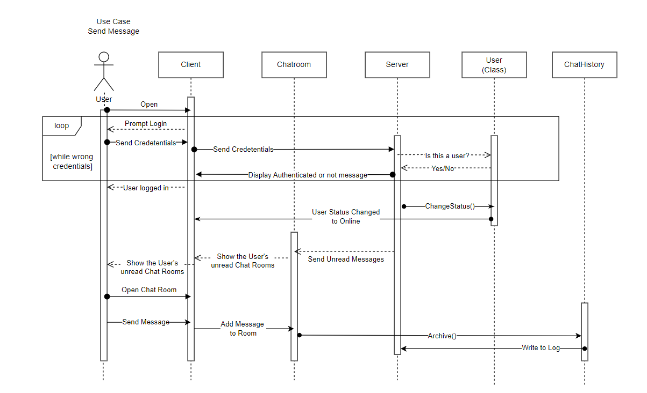

Slide 6
